Slide 1
The Books of Moses
– Fact or Fiction?
Today’s Topic:
The Origin of Earth and Our Universe: Intelligent Design or a Big Bang?

Slide 2
The Books of Moses
– Fact or Fiction?
This series of presentations will look at some of the miracles in the Books of Moses, the first five books of the Bible.
The miracles we will look at are Creation Week, covering both the creation of the physical universe and life, including mankind.

Slide 3
The Books of Moses
– Fact or Fiction?
Then we will cover the Fall of Mankind and look at how that would affect us.
After that, The Great Flood and its causes and effects on our world.
Next, the Tower of Babel and the Confusion of Languages.

Slide 4
The Books of Moses
– Fact or Fiction?
Then we will jump ahead to the Exodus of the Israelites from Egypt.
Finally, we will examine the Encounter with Jehovah God at Mount Sinai.
-I will try to present the Biblical Account, and then evidence for and against it.

Slide 5
The Books of Moses
– Fact or Fiction?
I have a Master’s degree in Applied Science, and am also a young Earth Creationist, so hopefully I can present the Biblical case with a scientific perspective, and also present the secular case without blind adherence to its beliefs.

Slide 6
The Books of Moses
– Fact or Fiction?
We will break for a cup of tea after about 45 minutes, then have another 45 minute session followed by 15 to 20 minutes of discussion.
Today’s topic is the creation of earth, and the physical universe, looking at the Biblical and Big Bang models.

Slide 7
Special Creation Model
Based on the Bible, primarily Genesis One
Requires the existence of an eternal God of unlimited intelligence and power.
Claims that our universe, and life, are the result of miraculous creative acts of that God.

Slide 8
The Big Bang Theory
Based on Naturalism, which is defined as:
“the philosophical belief that everything arises from natural properties and causes, and supernatural or spiritual explanations are excluded or discounted.”
It is therefore a model of the Origin of the Universe which excludes the actions of a Creator God.

Slide 9
Two Contrasting Belief Systems
Dictionary.com defines a religion as “a set of beliefs concerning the cause, nature, and purpose of the universe.”
Therefore both belief systems are religions.
One is Biblical Theism
  Offers Eternal Life in Paradise
The other is Naturalism, also referred to as Atheism.
  Offers meaninglessness and Eternal Death
Not Science vs Faith,
  But comparing two faiths with our universe.

Slide 10
Special Creation
Genesis 1:1 In the beginning God created the heavens and the earth.
  No Physical Universe
  Then Space Created
  Next, Earth Created

Slide 11
Special Creation
Gen 1:2 And the earth was formless and empty, and darkness was on the face of the deep. And the Spirit of God hovered on the face of the waters.
  Not created teaming with life.
  Surface completely smooth
  And covered with water
  And God’s Spirit was involved.

Slide 12
Special Creation
Gen 1:3 And God said, “Let there be light.” And there was light.
Gen 1:4 And God saw the light, that it was good: and God divided the light from the darkness.
Gen 1:5 And God called the light Day, and the darkness he called Night. And there was evening and there was morning: Day One.
  What, or Who, was the Light?
  Separation of light shows the Earth was a sphere
  Evening and Morning indicates Earth was rotating.

Slide 13

Early Earth- Only Ocean Seen

Slide 14
Special Creation
Gen 1:6 And God said, “Let there be an expanse in the midst of the waters, and let it divide the waters from the waters.”
Gen 1:7 And God made the expanse, and divided the waters which were under the expanse from the waters which were above the expanse. And it was so.
  Expanse is translated from Raqiya,
  Expanse used to divide the waters
    Some waters above, some below
    Not Vapour Canopy

Slide 15
Special Creation
The Hydroplate Theory (HPT)
Walt Brown (www.creationscience.com)
Granite Crust created in the waters
Rabbi Eliezer ben Hyrcanus (A.D. 80–118) said “the earth is spread upon the water just like a ship which floats in the midst of the sea.”
Spirit of God Still Hovering…

Slide 16
Special Creation
Gen 1:8 And God called the expanse Heaven. And there was evening and there was morning: Second day.
Could the Earth’s Crust be called Heaven?
  God walked on Earth with Adam and Eve
  Earth will become God’s Throne (Rev 21:1-7)

Slide 17
Special Creation
Gen 1:9 And God said, “Let the waters under the heavens be collected into one region, and let the dry land be seen.” And it was so.
Gen 1:10 And God called the dry land Earth and the collection of the waters He called Seas, and God saw that it was good.
  Waters under heavens collected together
  But called Seas
  Referring to waters above and below crust.
  Rabbi Eliezer ben Hyrcanus also had this to say: “Until the third day of creation, the earth was level as a plain and water covered the whole earth. When God said [Genesis 1:9], "Let the waters below the heavens be gathered," the mountains and hills arose and other parts became depressions. The waters filled these depressions and they were called seas.”

Slide 18
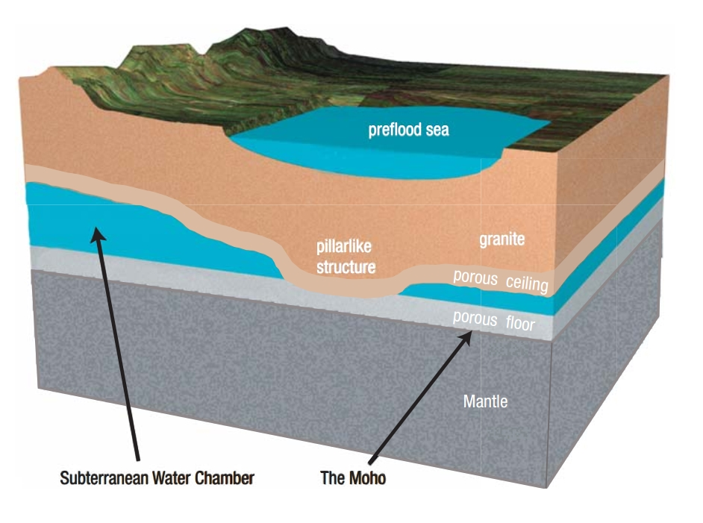
Special Creation –Preflood Crust

Slide 19
Special Creation
Why was Earth so Special to God?
Col 1:15-17 indicate that Jehovah God created Earth for His Son.
  Col 1:15 He is the image of the invisible God, the firstborn over all creation.
  Col 1:16 For by Him all things were created that are in heaven and that are on earth, visible and invisible, whether thrones or dominions or principalities or powers. All things were created through Him and for Him.
Col 1:17 And He is before all things, and in Him all things consist.
Rev 4:10-11 show that God also created it for His own pleasure.
  Rev 4:10 the twenty-four elders fall down before Him who sits on the throne and worship Him who lives forever and ever, and cast their crowns before the throne, saying:
  Rev 4:11 “You are worthy, our Lord and our God, to receive glory and honour and power; for You created all things, and for Your pleasure they exist and were created.”

Slide 20
Special Creation
Gen 1:14 And God said, “Let there be lights in the expanse of the heavens to divide between the day and the night; and let them be for signs, and for appointed times, and for days, and years:
Gen 1:15 “And let them be for lights in the expanse of the heavens to give light upon the earth.” And it was so.
Gen 1:16 And God made two great lights and the stars: the greater light for ruling the day, and the lesser light for ruling the night.
  Expanse of the heavens in plural
  Greater light- our Sun – not ordinary
  Lesser light – our Moon – not scarred yet.
  Rest of Solar System created.

Slide 21
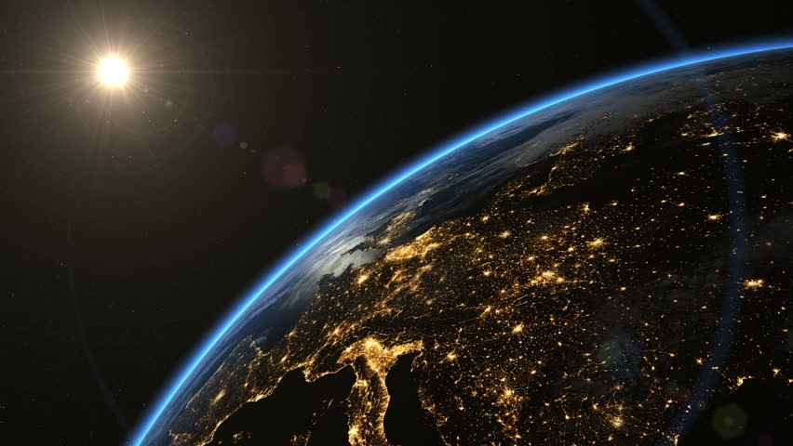
Late Evening In Europe - NASA

Slide 22
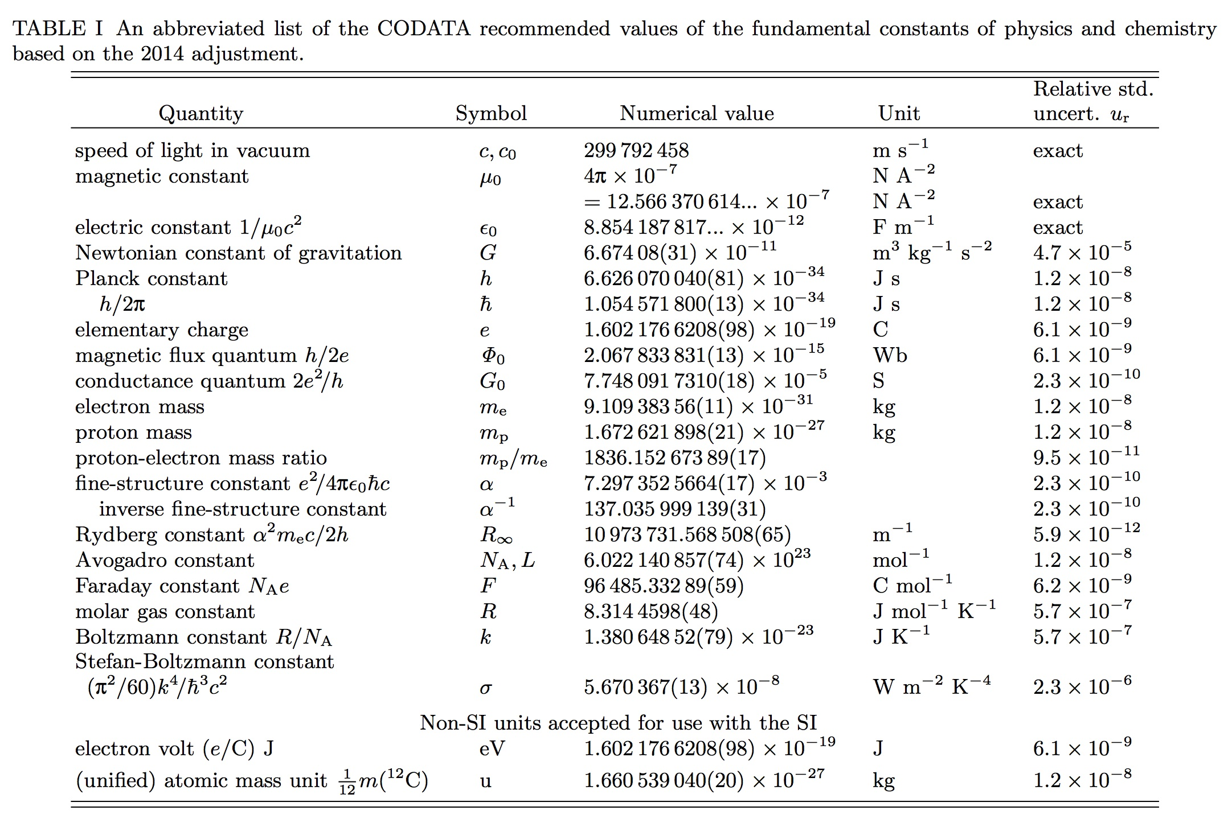

Slide 23
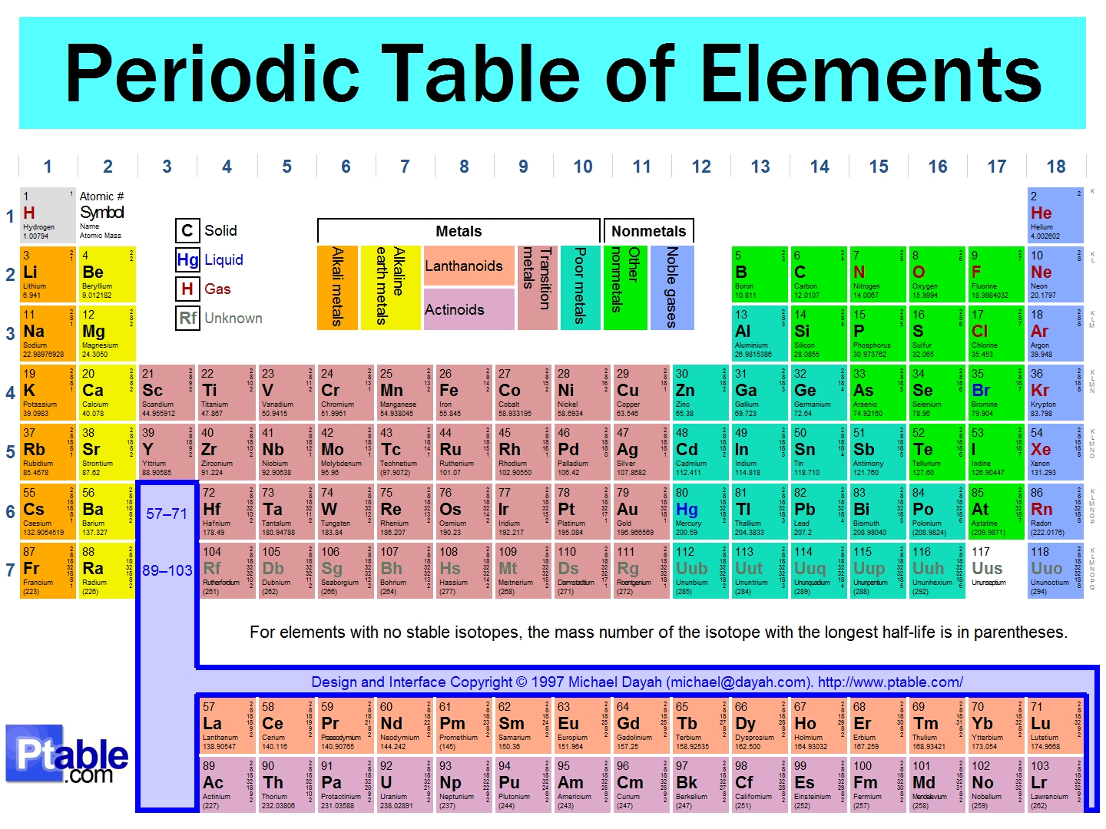

Slide 24
Special Creation
And the Stars
200 billion trillion stars
My modified model of stellar Formation:
Initial sphere of space about 5000 light year radius.
As the stars, galaxies and galactic clusters are formed, they are spread out into space
Isa 48:13 Indeed My hand has laid the foundation of the earth, and My right hand has stretched out the heavens; when I call to them, they stand up together.

Slide 25
Special Creation
As each layer is formed and spread out, a new layer is created closer to earth.
First layer needs most expansion.
Space expands as the layer expands.
Last layer needs the least expansion
Our Galaxy and nearby stars
Gravitational bonds stronger than spreading force
John Hartnett: Starlight, Time and the New Physics
  Carmeli relativity physics alter time in expanding universe
  Allows us to see light from galaxies billions of light years away
  Expansion explains the Cosmic Microwave Background
Adam and Eve see a gradual increase in stars

Slide 26
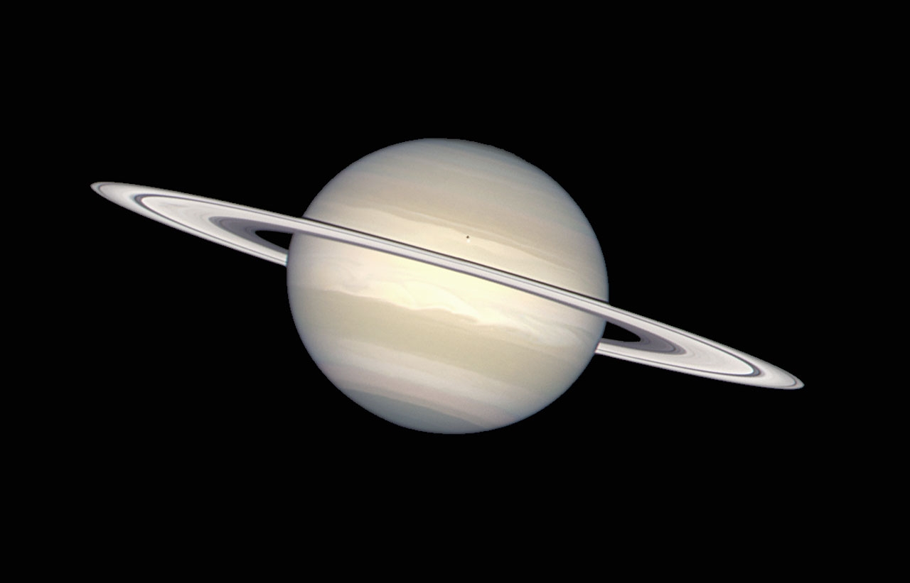
Saturn, with its young rings-ESA/Hubble

Slide 27
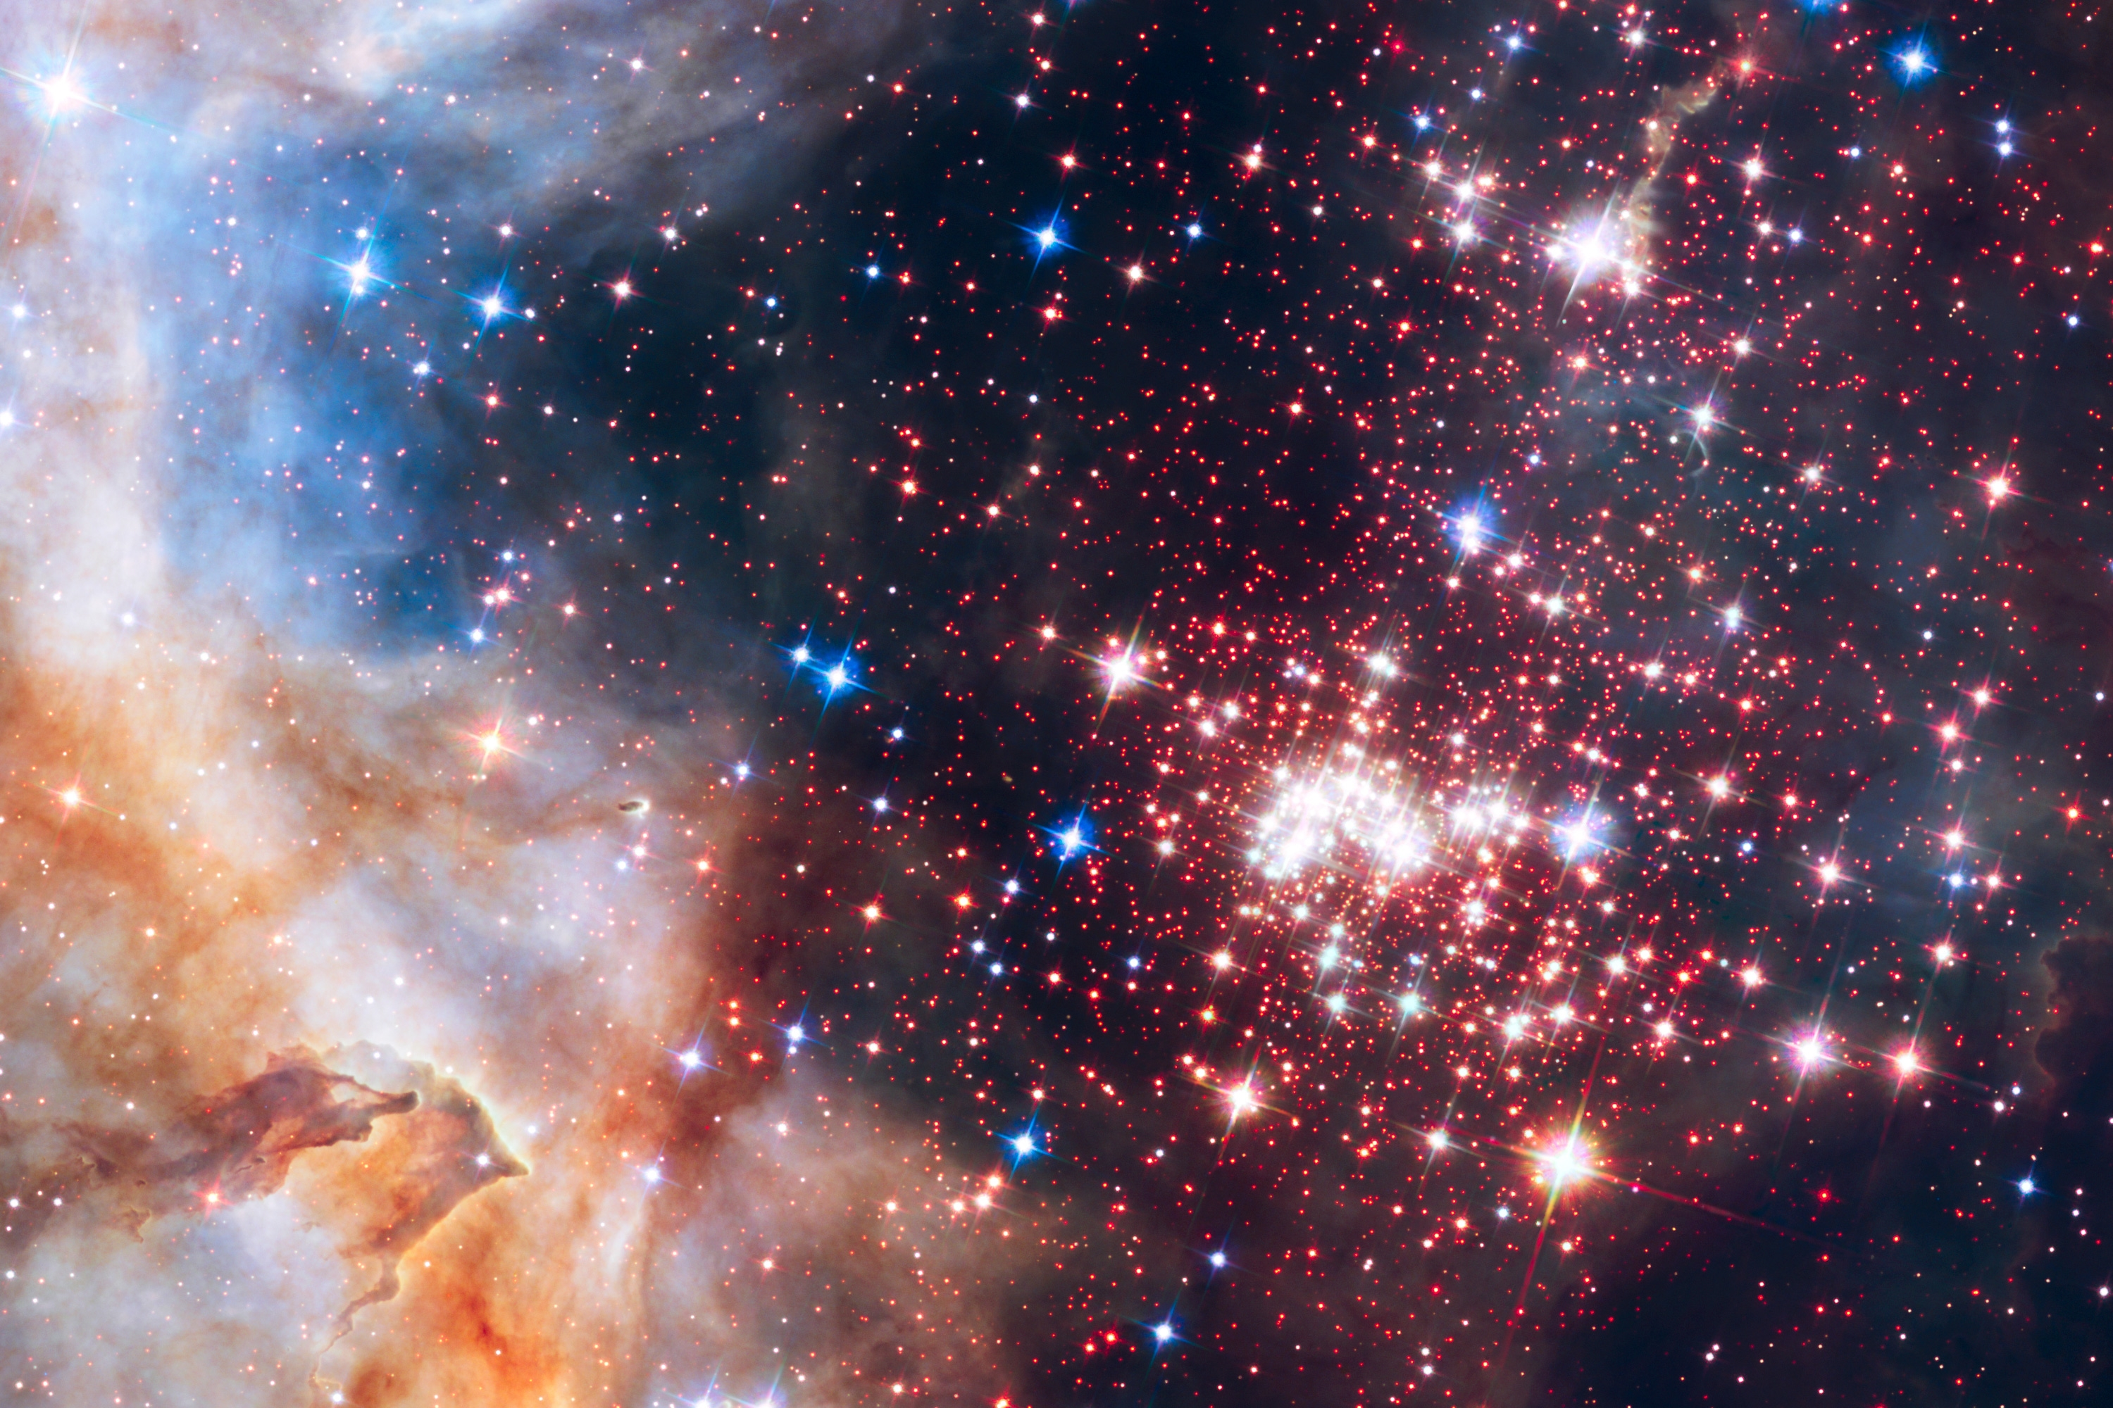
Westerlund 2 Star Cluster - Hubble

Slide 28
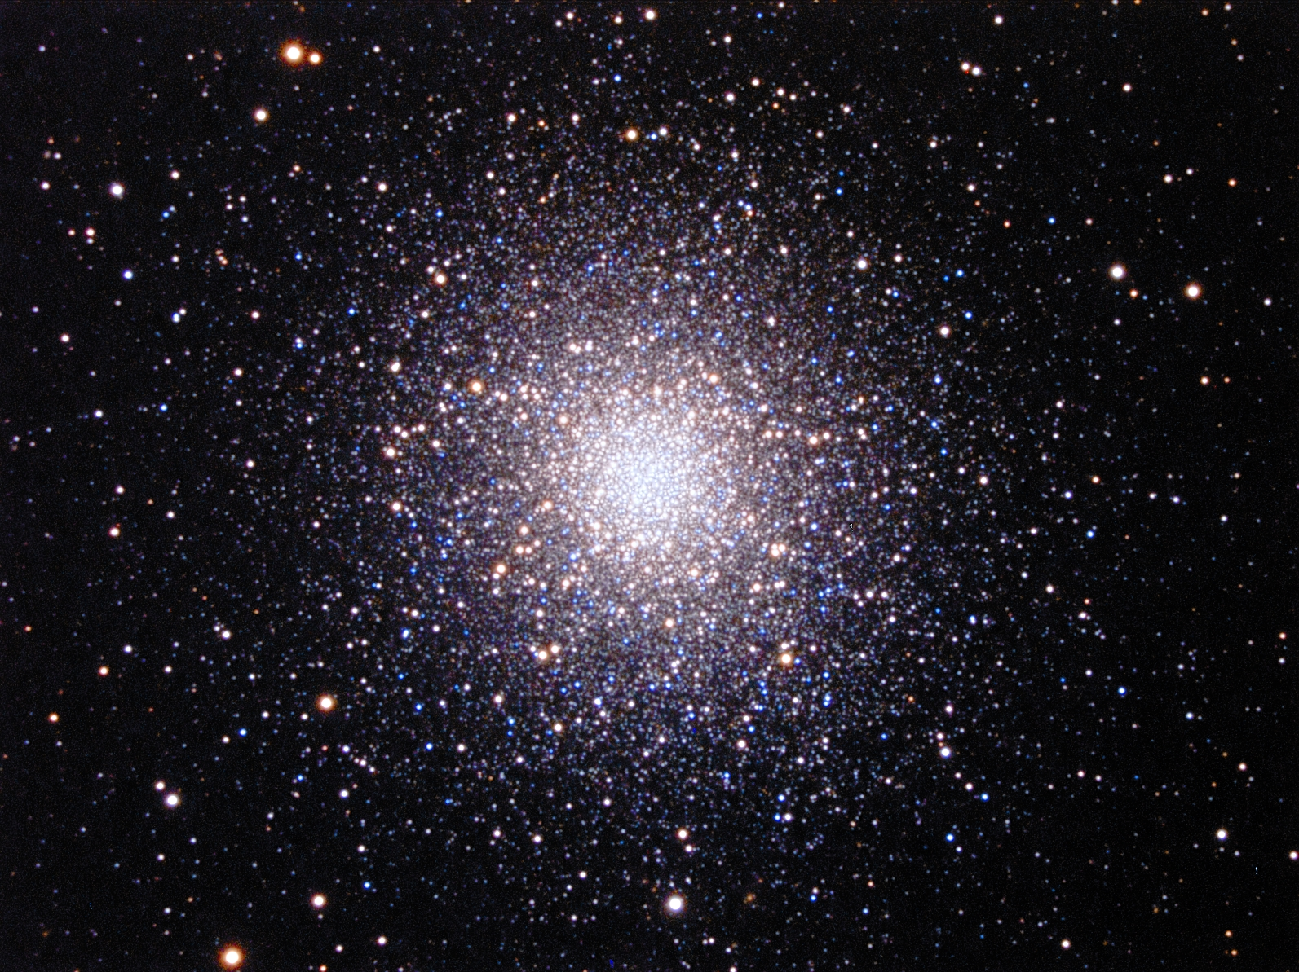
Globular Cluster M13 - Hubble

Slide 29
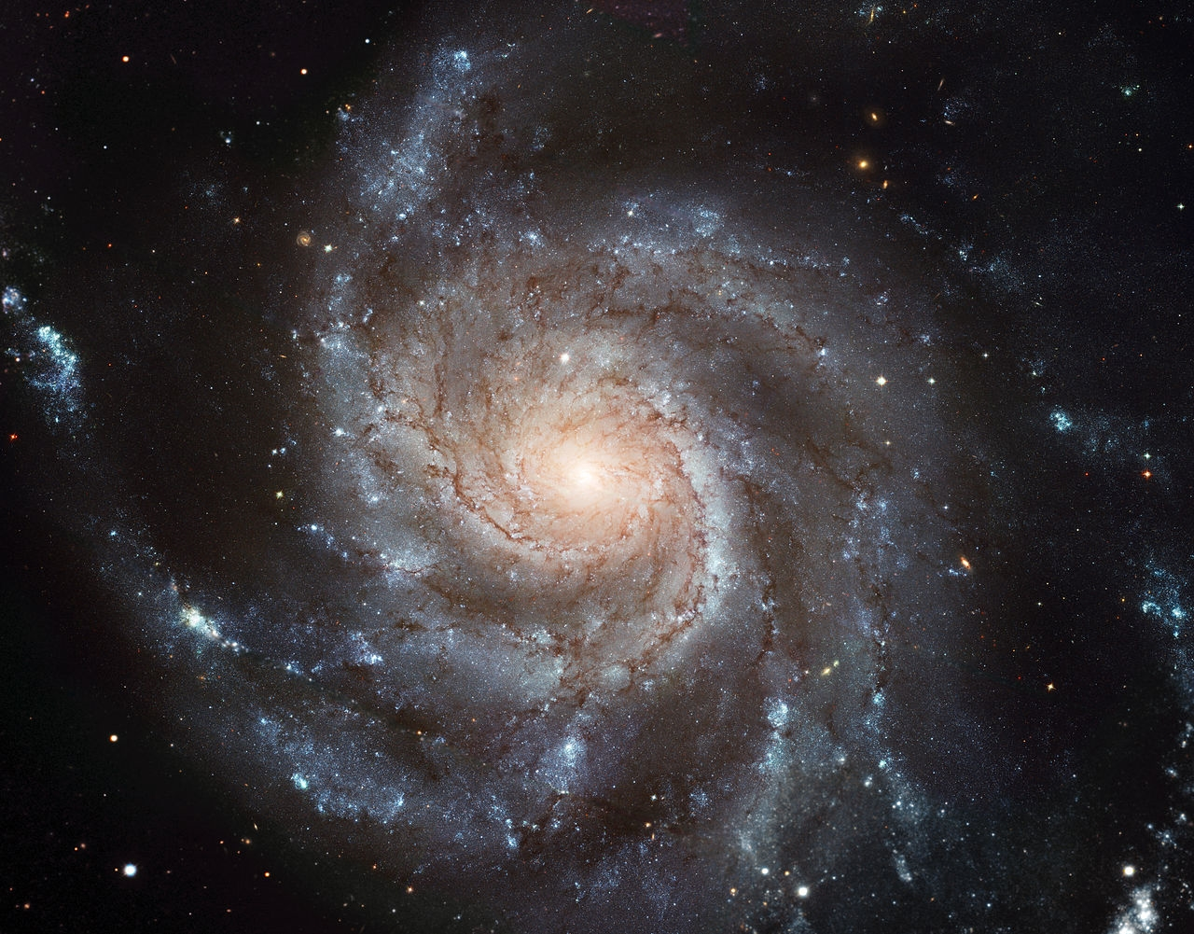
Spiral Galaxy, like Milky Way- NASA

Slide 30
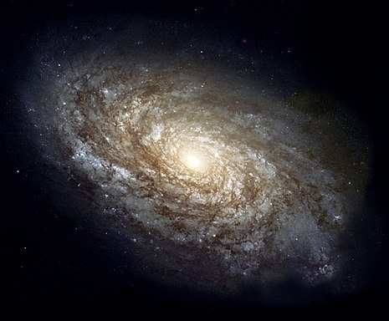
Galaxy with dust - NASA

Slide 31
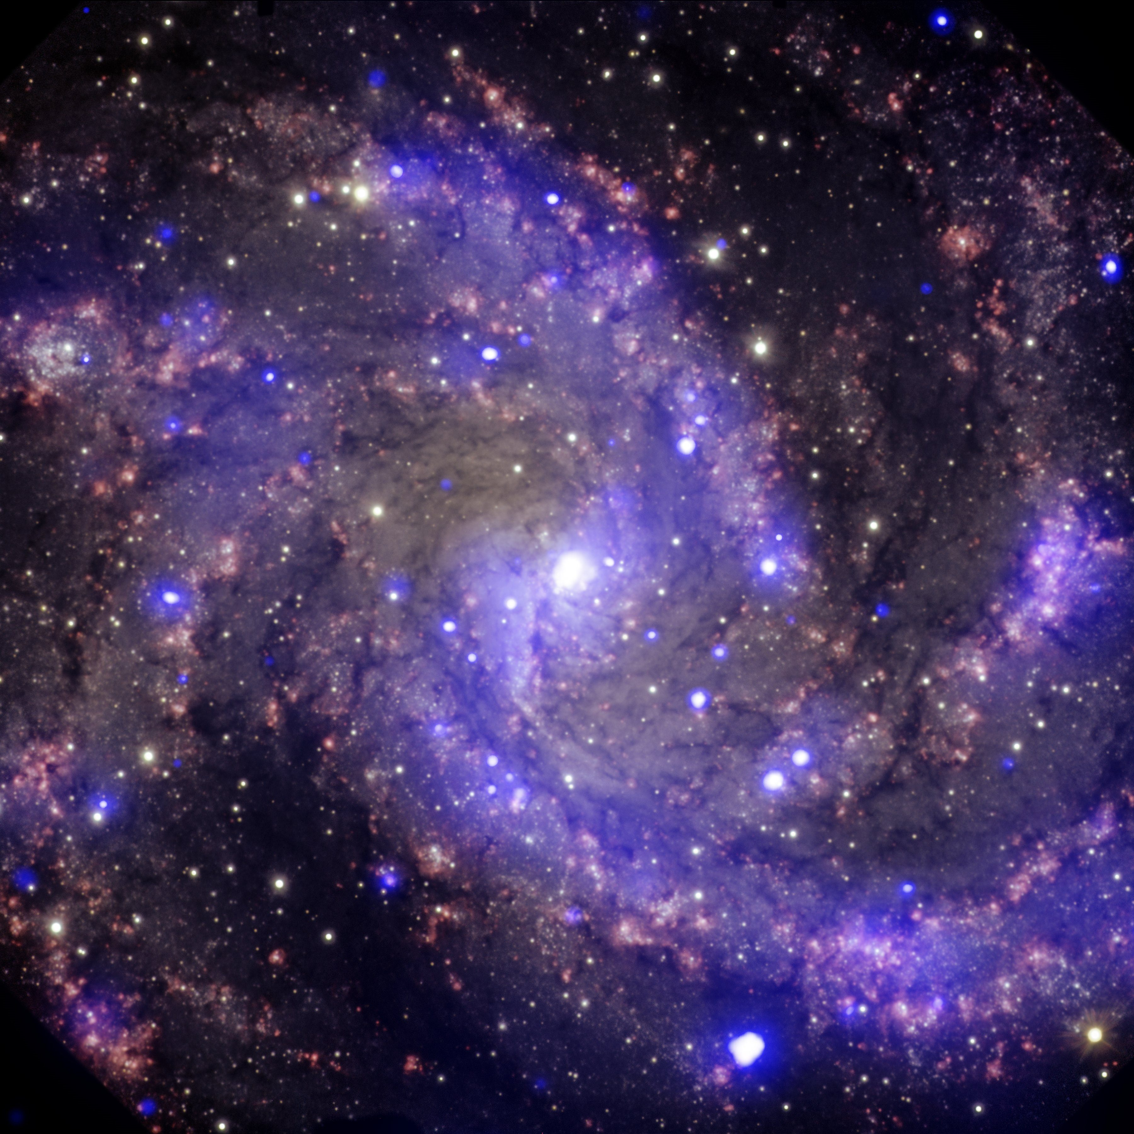
Fireworks Galaxy - NASA

Slide 32
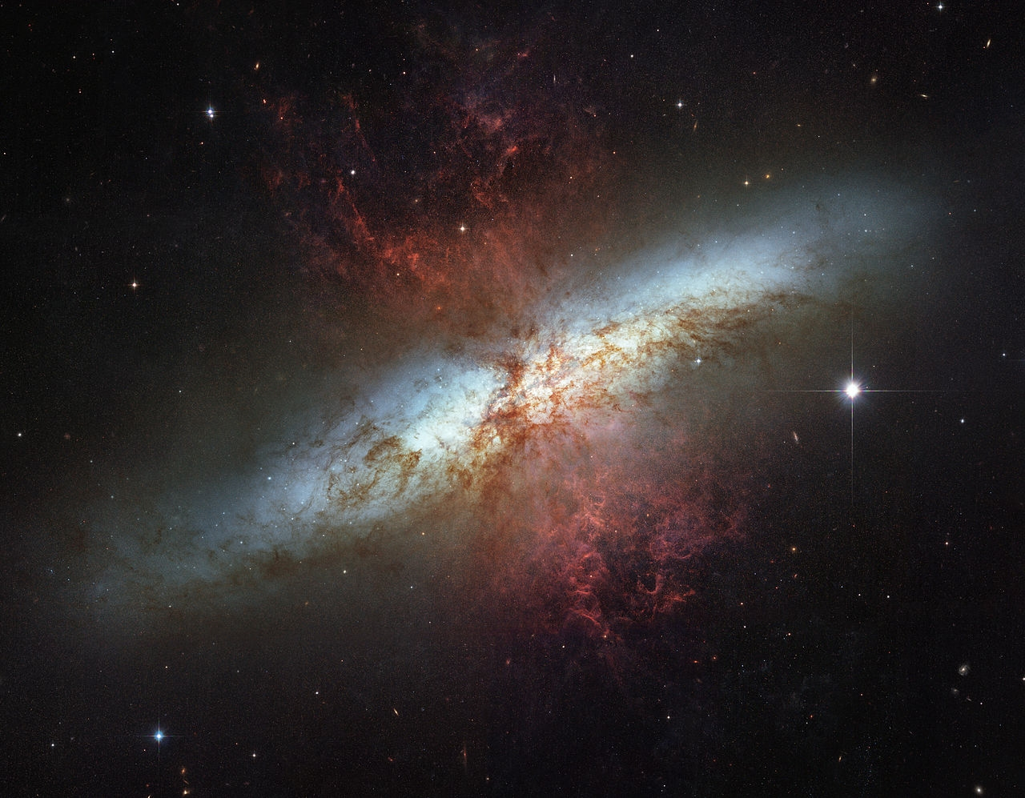
Galaxy behind Nebula - NASA

Slide 33
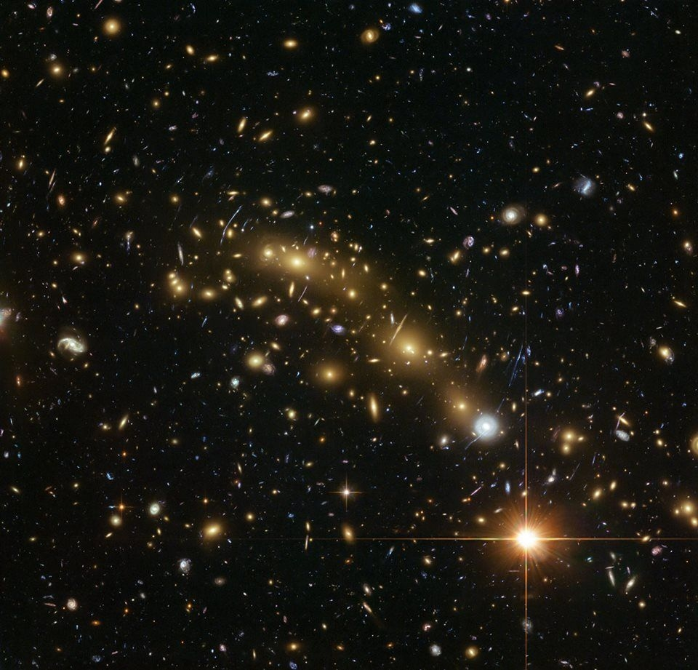
Galaxy Cluster - ESA

Slide 34
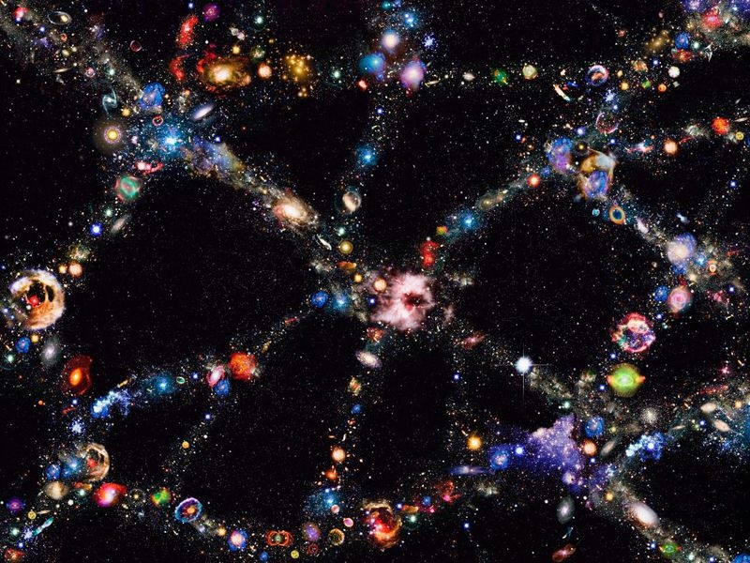
BOSS Great Wall Supercluster - Smithsonian

Slide 35
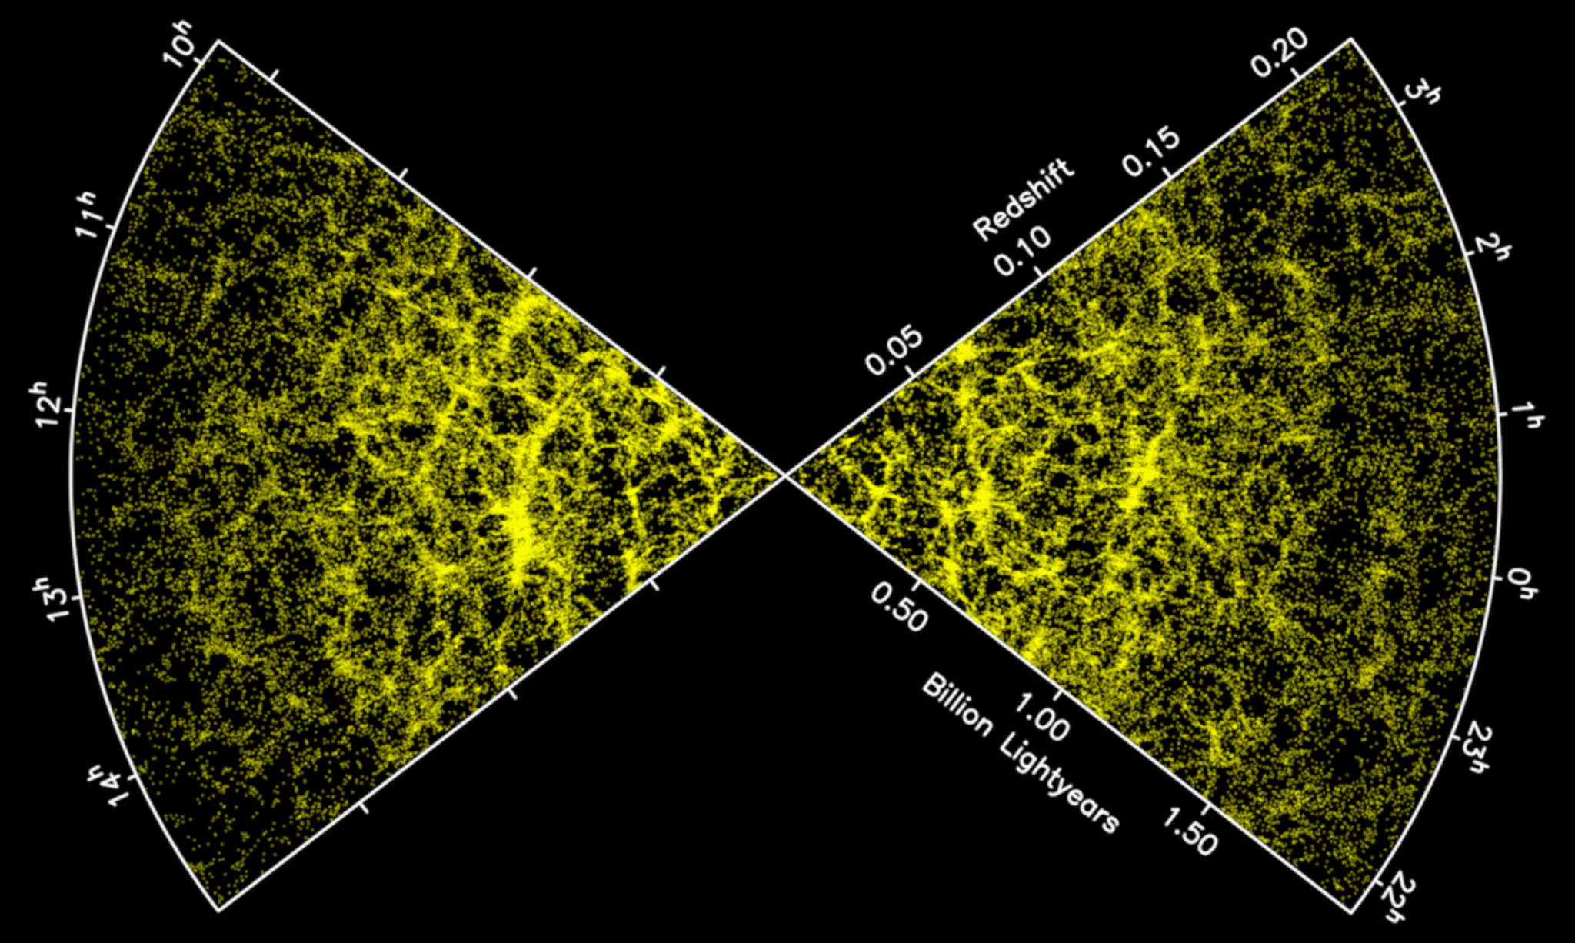
Galaxy Distribution
2dF Survey

Slide 36
Big Bang
Standard Sources are Stephen Hawking and Wikipedia:
https://www.youtube.com/watch?v=gs-yWMuBNr4
https://en.wikipedia.org/wiki/Big_Bang
Critical Sources are:
In the Beginning by Walt Brown
Evidence Against the Big Bang by Bob Enyart

Slide 37
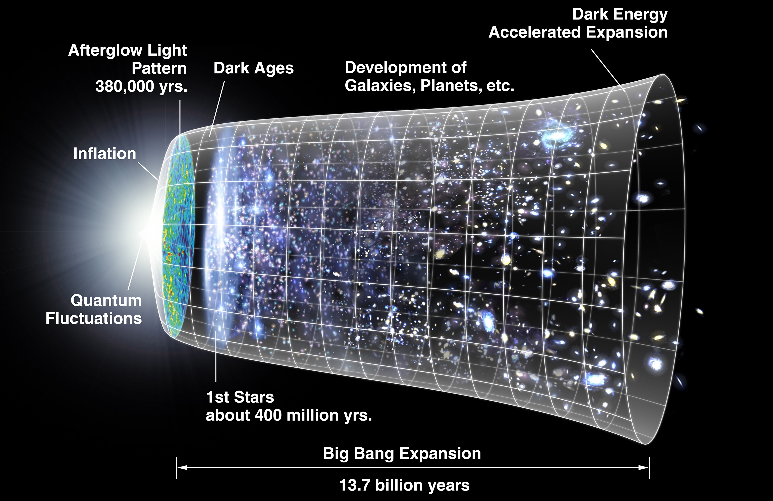
NASA

Slide 38
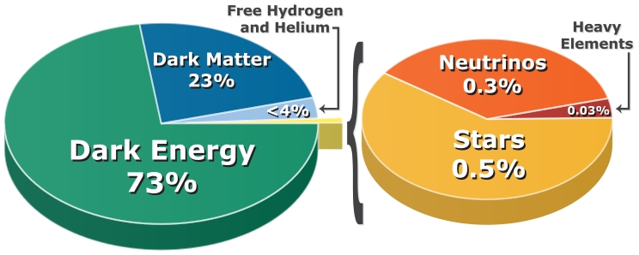
Big Bang’s Darkness – Ben Finney

Slide 39
Big Bang Elements
Theory says elements heavier than iron are made in Supernovas
Recent analysis of supernova spectrums show NO heavy elements.
Many heavy elements, such as copper, zinc, molybdenum and iodine are essential for human life.

Slide 40
Big Bang Solar System
Can’t explain many details of our Solar system’s planets and moons
Can’t explain the origin of Earth and our Moon
Claim the Earth is 4.54 Billion years old. Problems with this:
  Moon’s Recession and Killer Tides
  Moon Dust
  Coral Growth
  Stalagmites and stalactites
  Continued…

Slide 41
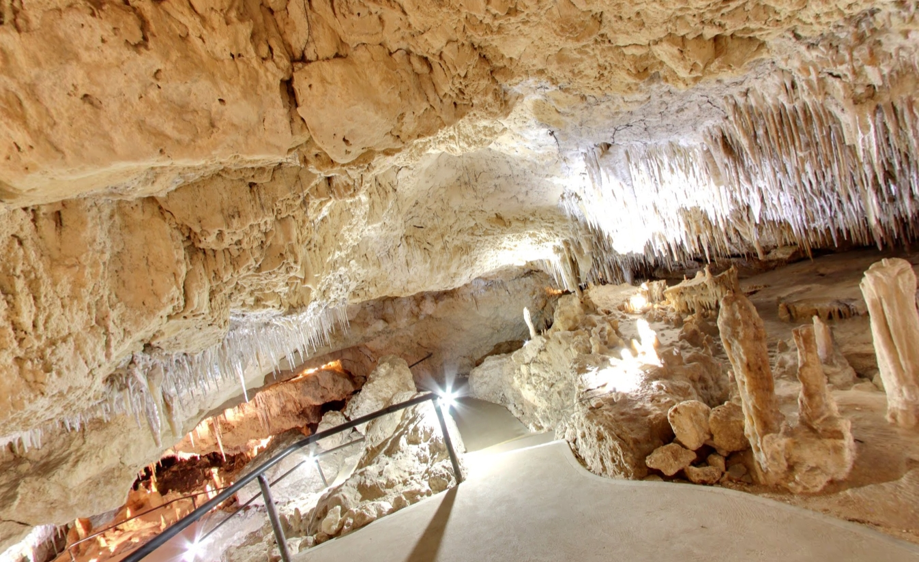
Kelly Hill Cave Kangaroo Island

Slide 42
Big Bang Earth Problems
Old Earth Problems
  Volcanic Eruptions – max of 100 M years
  River Sediments – max of 30 M years
  Dissolved Metals in Oceans – max of 1 M yrs
  Helium in Zircons – max of 10,000 years
  Human Footprint on Squashed Trilobite
  Proteins and Soft Tissue in Dinosaur ‘fossils’
    Max of 10,000 years

Slide 43
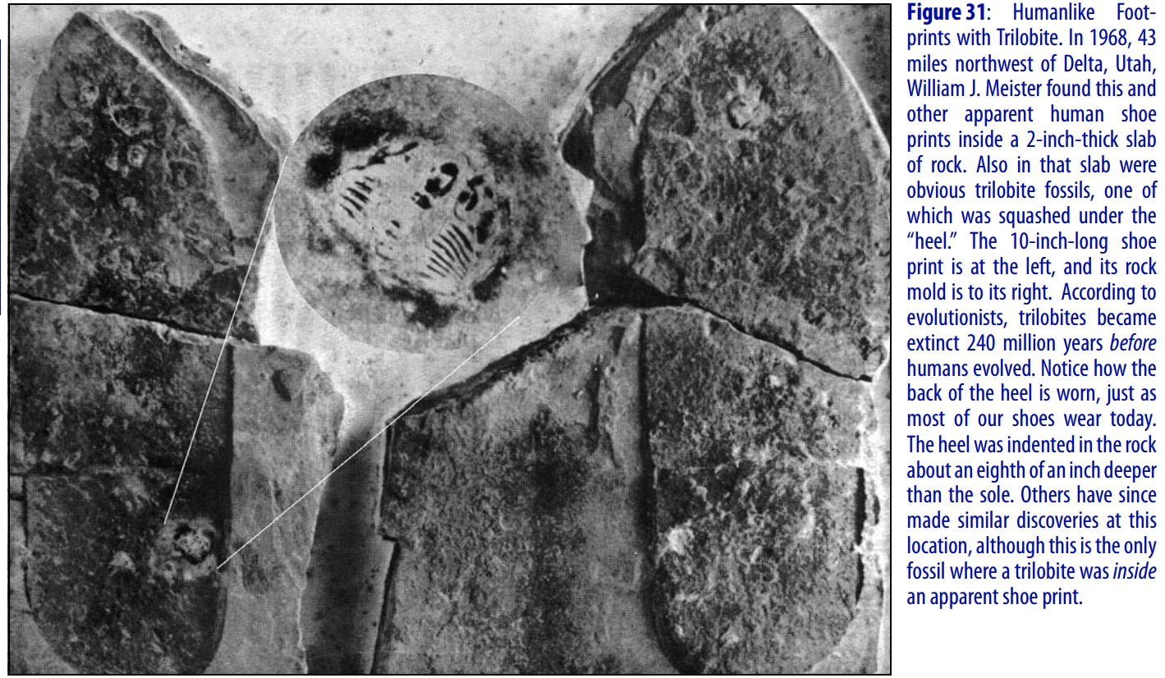

Slide 44
Big Bang Earth Problems
Earth and Venus are Twins??
  Venus has a toxic, high pressure atmosphere
  Venus has no water
  Venus day is 117 earth days long.
  Venus has no seasons
  Venus has no moon
  Venus has no magnetic field
  Earth is very special.

Slide 45
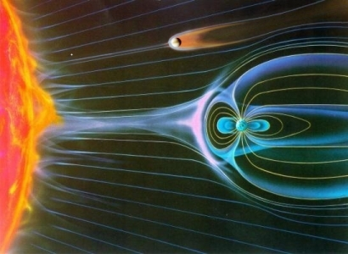
Venus and Earth’s Magnetic Fields - Wiki

Slide 46
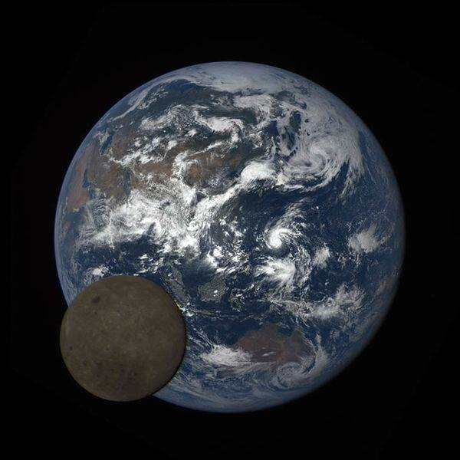
Earth and Moon - NASA

Slide 47
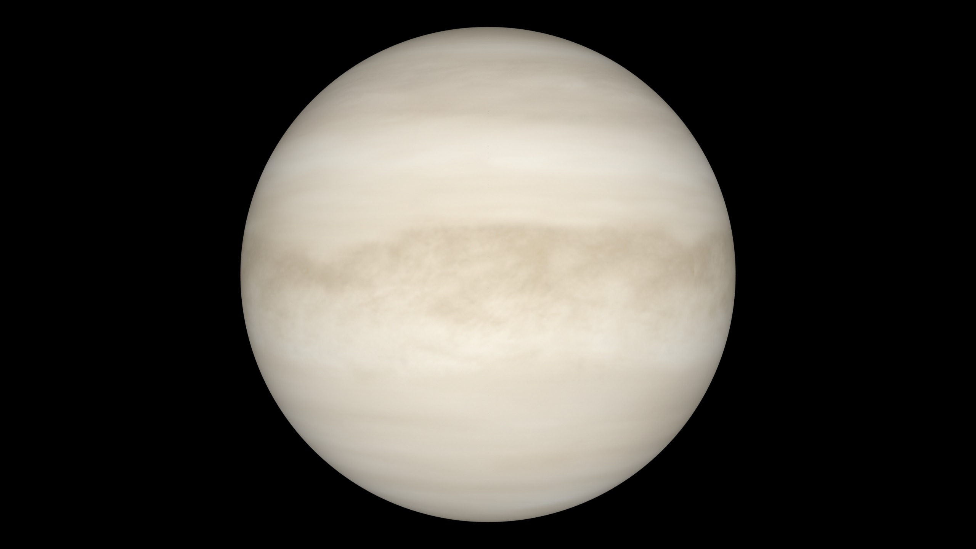
Venus – our Twin Planet - ESA

Slide 48
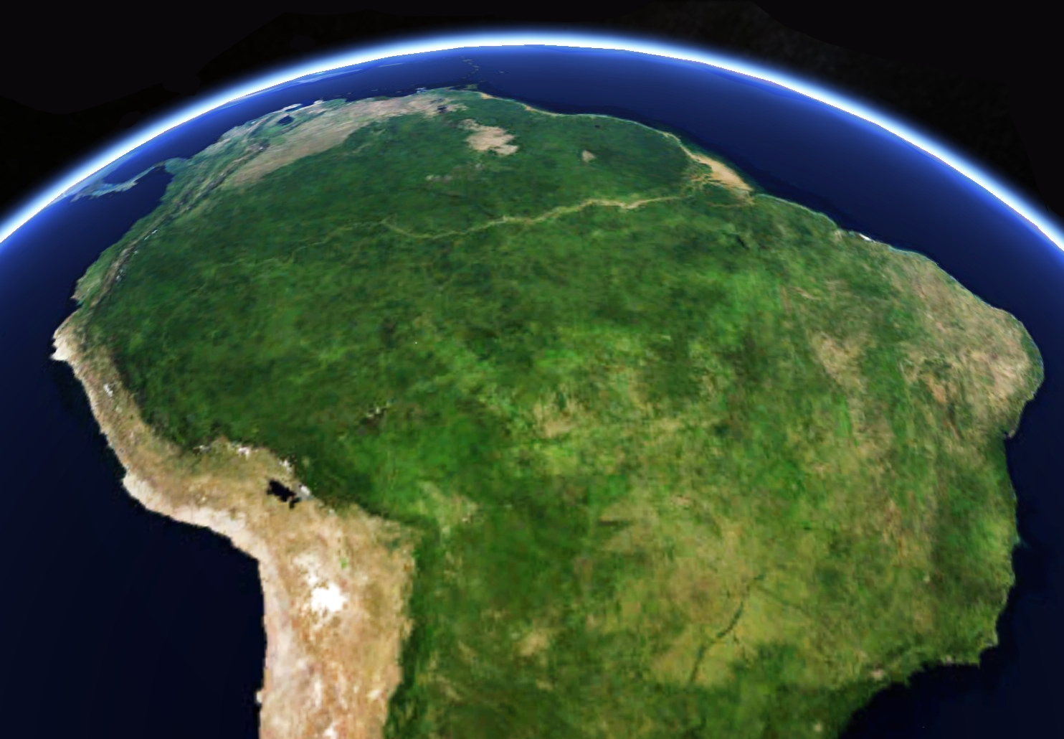
Earth –Amazon - NASA

Slide 49
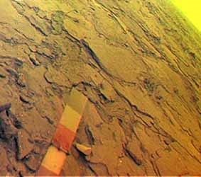
Venus Surface - Russia

Slide 50
Cosmic Microwave Background
Claimed as a prediction of Big Bang Theory
  CMB was known before BB theory proposed.
CMB is centered on Earth
  Anathema to Atheists

Slide 51
Big Bang Rebellion
Open Letter to the Scientific Community
SERIOUS QUESTIONS ABOUT THE VALIDITY OF THE UNDERLYING THEORY
  Inflation, dark matter, dark energy, etc.
    All fudge factors
  No quantitative predictions
  Signed by over 400 scientists and engineers

Slide 52
Conclusion
Both models require many miracles
Only Biblical Special Creation has a Creator with the intelligence and ability to perform the required miracles.
Our observed universe fits much better with the Biblical Special Creation than the Big Bang model.
Next Topic: The Origin of Life: Special Creation or a Natural Process?

Slide 53
Written by Bruce Armstrong
M App Sci
Published by
CENTRAL HIGHLANDS CHRISTIAN PUBLICATIONS
PO Box 236, Creswick, Vic 3363 Australia
Email info@chcpublications.net
Web Page http://www.chcpublications.net
Copyright © 2018

